Slide 2
Mission objectives and targets
Restore our Ocean and Waters by 2030
Protect and restore marine and freshwaters ecosystems and biodiversity
Protect at least 30% and strictly protect 10% EU’s sea areas
Prevent and eliminate pollution of our oceans, Seas and waters
Make the blue economy carbon- neutral and circular
Net zero maritime emissions
Zero carbon aquaculture,
Reduce by at least 50% plastic litter
Restore 25.000 km free flowing rivers
Marine nature restoration targets (incl. degraded seabeds, coastal ecosystems)
Reduce by at least 30% microplastics
Reduce by at least 50% nutrient losses, chemical pesticides
Low carbon multipurpose use of marine space
ENABLERS
Digital Ocean and Waters Knowledge system
Public mobilization and engagement

Slide 3
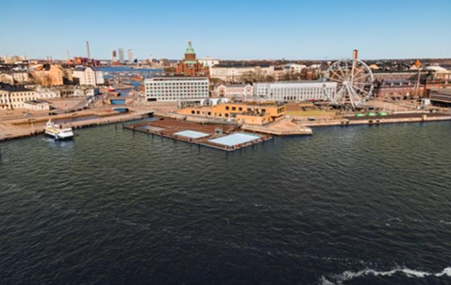
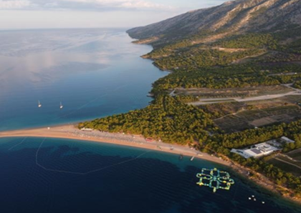
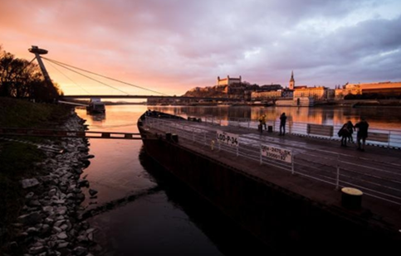
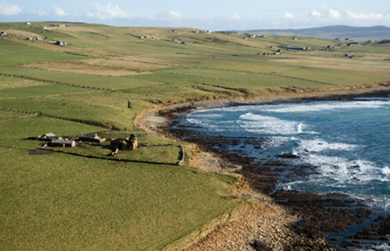
Mission lighthouses: spaces of transformation to pilot, demonstrate, develop and deploy the Mission activities across EU
Baltic & North sea basin
Mediterranean sea basin
Make the blue economy carbon- neutral and circular
Prevent and eliminate pollution of our ocean, seas and waters
Danube river basin
Atlantic & Arctic coast
Protect and restore marine and freshwaters ecosystems and biodiversity

Slide 4
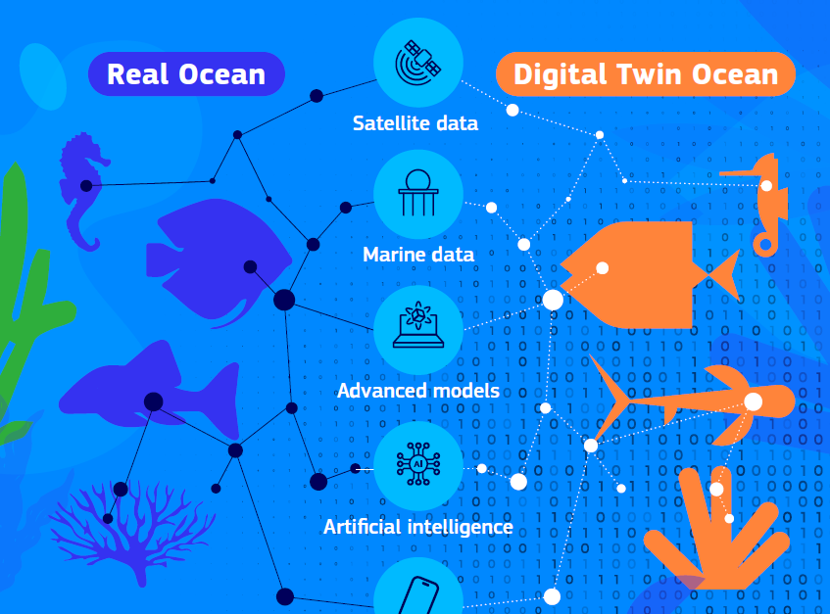
Enabler: European Digital Twin of the Ocean

Slide 5
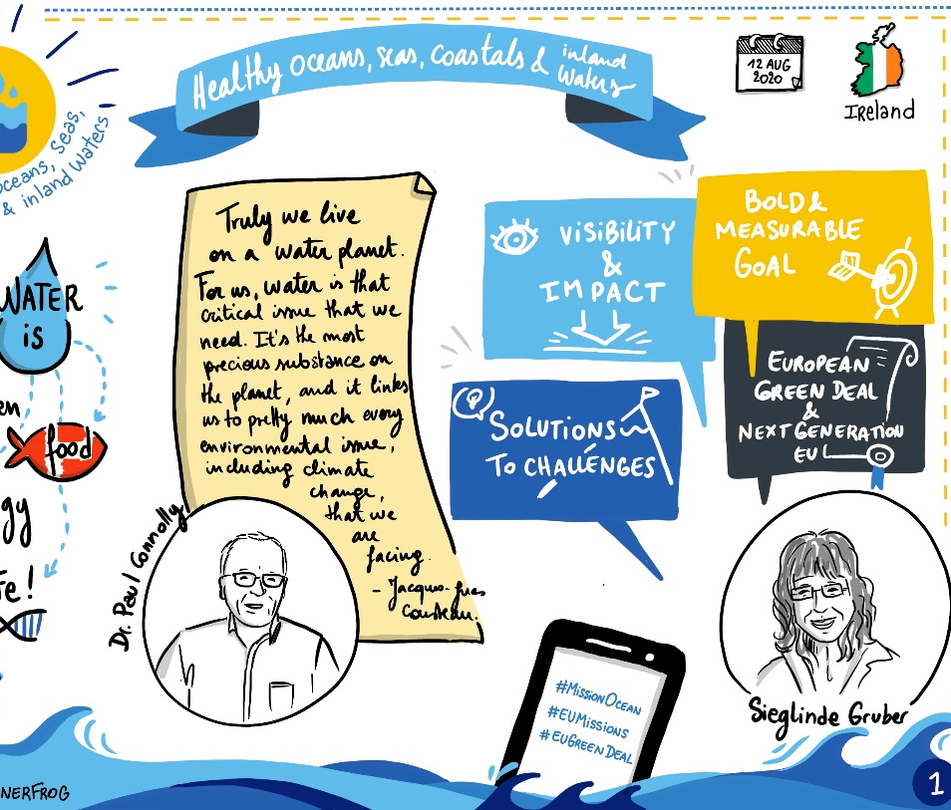
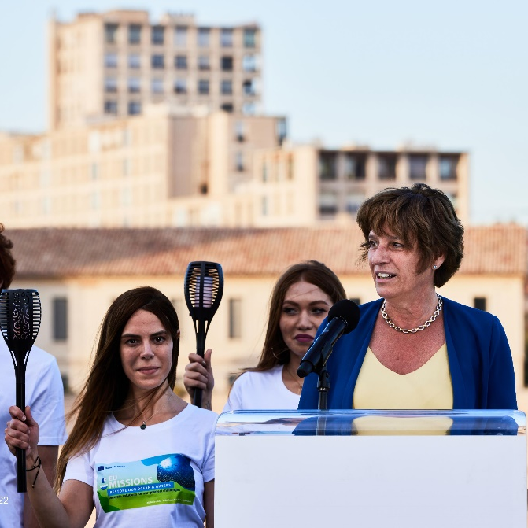
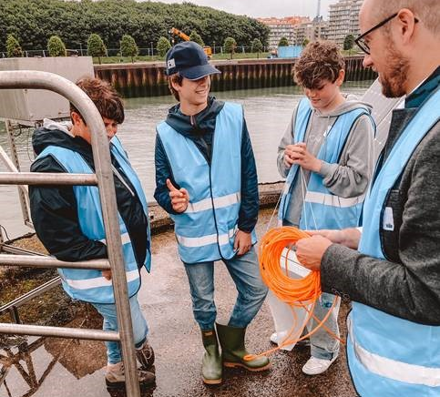
Enabler: Public Mobilisation
Co-creation and co-design
ERA Plastic Pirates
Education, Literacy & Awareness
Stewardship and volunteering
Community-driven business models
CSA Citizen Science
Youth engagement
Choose your fish campaign
Student and school initiatives (Blue Schools, EU4Ocean)
Co-design of Mission
Citizen Assemblies
Citizen Science

Slide 6
HE Mission Work programmes 2021-2023
Calls closed on 12 April,
Evaluations ongoing
EUR 114.3 million
WP adoption on 11 May, Calls opened on 12 May,
calls closing on 27 September 2022
EUR 117.9 million
In preparation
Adoption: Dec 2022 (tbc)
EUR 111.9 million
2021
2022
2023

Slide 7
EU Support for Mission
EU strategic and financial support for Mission lighthouses
Baseline studies (HE)
Portfolio of projects and initiatives (HE and other programmes)
Coordination and Support Actions (HE)
Mission Implementation Platform (HE)
Implementation Charter

Slide 8
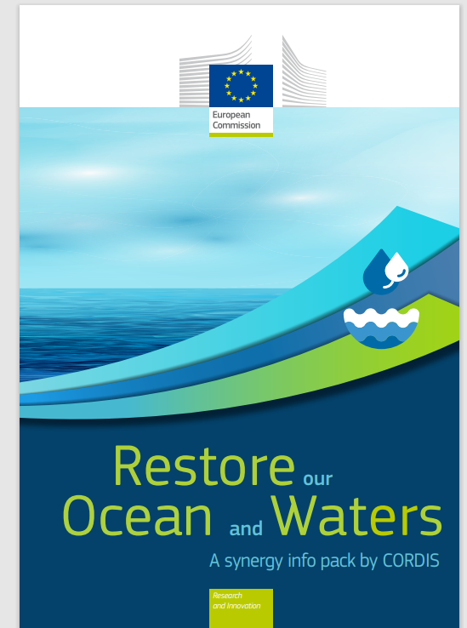
SYNERGIES – Teaming up beyond EC / HE level
Across different EU Programmes
Horizon Europe, EMFAF, Life, Inter-Reg, InvestEU
With Member States and Regions
National and regional programmes / initiatives, partnerships
With International partners / initiatives
UN Decade Ocean Sciences, UfM, Alliances (e.g. AAORA)
With public & private sectors, and investors
Universities, Joint Undertakings, EIB, EBRD, philanthropy
With citizens and youth
Citizens initiatives, EU4Ocean, Youth ocean Ambassadors

Slide 9
Mission Charter: A joint commitment to Restoring our Ocean and Waters
Sense of ownership: join forces for a transformational change for a healthy ocean and waters, thus contributing to the EU Green Deal objectives
Community of practice: a simple, inclusive, efficient and inspirational framework to enhance cooperation to deliver on Mission objectives
Non-binding engagement, open to any public or private interested parties

Slide 10
Usefull links:
Missions page: https://research-and-innovation.ec.europa.eu/funding/funding-opportunities/funding-programmes-and-open-calls/horizon-europe/eu-missions-horizon-europe_en
Mission Ocean page: https://research-and-innovation.ec.europa.eu/funding/funding-opportunities/funding-programmes-and-open-calls/horizon-europe/eu-missions-horizon-europe/restore-our-ocean-and-waters_en
Mission Ocean Charter activity submission: https://ec.europa.eu/eusurvey/runner/MissionOceanWatersCharter

Slide 11
#MissionOcean
#EUmissions
#HorizonEU

